Slide 1

Basic Details of the Team and Problem Statement
Problem Statement Title: Real-Time Vehicle Tracking system.
Theme Name: Smart Vehicles
Team Name: Tech Titans
Team Leader Name: Aadithya S Nair
School Code:830092
School Name: Delhi Public School Bangalore North

Slide 2
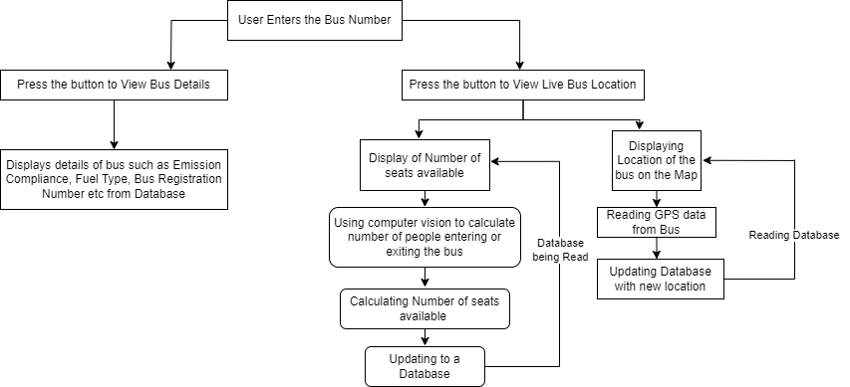
Idea/Approach Details
Idea:
A Real-Time Vehicle Tracking System that represents a groundbreaking advancement in public transportation. By harnessing the power of GPS and sophisticated data services, this system offers users immediate access to crucial information regarding bus availability and anticipated arrival times. With a primary focus on environmental sustainability, This technology-driven solution seeks to elevate the efficiency and convenience of public transportation, promising a more seamless and eco-conscious commuting experience.
Process Flow Chart
Describe your Technology stack here:
Frontend:(User Interface): HTML5, CSS3, JavaScript (ES6+)
Backend:
Server-Side Language: Python
Web Framework: Flask
Database:
Relational Database: MySQL
Mapping and Location Services:
Mapping API: Google Maps API
API Integration:
Third-party APIs: Google Maps Directions API, Google Maps Geocoding API, Traffic APIs.

Slide 3
Idea/Approach Details
Describe your Use Cases here
Describe your Dependencies / Show stopper here
. Real-Time Bus Location Tracking:
Users can view buses' live locations on a map for accurate boarding planning..
Estimated Time of Arrival (ETA):
Receive real-time bus arrival predictions based on live traffic data.
Emission Compliance Information:
Access bus environmental ratings (e.g., Bharat Stage) for eco-conscious choices.
Clean Fuel Usage Indication:
Identify buses using eco-friendly fuels like CNG or electricity for sustainable travel options.
Dependencies
GPS Hardware and Technology: Reliable GPS hardware and technology are essential for accurate real-time tracking of buses.
Internet Connectivity: Continuous internet connectivity is crucial for accessing real-time data, maps, and providing updates to users.
Mapping and Location Services: Dependence on mapping services like Google Maps API or similar for accurate geolocation data.
Traffic Data Providers: Relying on third-party traffic data providers for up-to-date traffic conditions.
API Integrations: Integration with external APIs for services like traffic updates, emissions data, etc.
Show Stopper
Lack of Reliable GPS Data: Inaccurate or unreliable GPS data can severely impact the accuracy of bus tracking.
Unavailability of Live Traffic Data: Without access to live traffic updates, ETA predictions may be less accurate.
Poor Internet Connectivity: Users in areas with weak or no internet connectivity may face challenges in accessing real-time information.
Dependency on Third-Party Services: Reliance on external services (e.g., mapping APIs) means potential disruptions if those services experience downtime.
Hardware Failures: Failure of GPS devices on buses or other hardware components could disrupt real-time tracking.

Slide 4
Team Member Details
Team Leader Name: Aadithya S Nair
Class: 12th Stream: Science Age :17 Gender (M/F): M
Team Member 1 Name: Harry R
Class: 12th Stream: Science Age : 17 Gender (M/F): M
Team Member 2 Name: Niyati Reddy E
Class: 12th Stream: Science Age : 18 Gender (M/F): F
Team Mentor 1 Name: Varsha Vijay
Category :Academic Expertise (AI/ML/Blockchain etc.): Domain Experience (in years):

